Slide 1

ENGINEERING
PROJECT
PROPOSAL
“FREELANCEFLOCK“
A revolutionary freelancer collaboration platform designed to streamline project management and foster creative collaboration.
Here is where your presentation begins
By – Het Patel

Slide 2
Overview
Freelancer Collaboration Platform, the ultimate solution for streamlining project management and fostering creative collaboration. Designed with freelancers and businesses in mind, our platform offers a comprehensive suite of features to enhance efficiency and communication. With real-time messaging, video conferencing, and file sharing capabilities, freelancers can collaborate seamlessly, while our robust project management tools ensure tasks are assigned, tracked, and completed efficiently.
What sets us apart is our focus on tailored collaboration environments and dedicated support. Whether you're a freelancer looking for opportunities or a business seeking talent, our platform matches you with the right projects and provides the necessary resources to succeed. Plus, our commitment to innovation means we're constantly evolving, with future add-ons including AI-powered insights, blockchain integration, and virtual reality workspaces. Join us in shaping the future of freelance collaboration and unlocking new possibilities for success.

Slide 3
Features
Real-Time Collaboration
01
Project Management Tools
02
Secure Payment System
03
Skill Matching Algorithm
04
Feedback and Rating System
05
Instant messaging, video conferencing, and file sharing capabilities to facilitate communication among team members.
Task assignment, milestone tracking, and progress monitoring for efficient project management.
Built-in payment gateway to ensure secure transactions between clients and freelancers.
Advanced algorithm matches freelancers with projects based on skills, experience, and availability.
Transparent feedback mechanism to maintain quality standards and build trust within the community.

Slide 4
Future developments and enhancements
Innovation
Tailored Collaboration Environments: Customized workspaces for diverse industries and projects, empowering freelancers with essential tools for success.
Advanced Skill Matching Algorithm: Cutting-edge algorithm connects freelancers to projects based on expertise, ensuring high-quality outcomes and client satisfaction.
Real-Time Communication Tools: Seamless messaging, video conferencing, and file sharing foster collaboration among freelancers, irrespective of their location.
Secure Payment System: Ensuring prompt payments for freelancers and peace of mind for clients with our robust and protected transaction system.
Payment Automation: Automating payment processes to ensure timely and accurate payments for freelancers, reducing administrative overhead and improving financial transparency.
Communication Automation: Implementing automated communication systems, such as chatbots and automated notifications, to facilitate real-time communication and keep stakeholders informed throughout the project lifecycle.
AI-Powered Project Insights: Future AI analytics for project performance, enhancing efficiency for freelancers and clients.

Slide 5
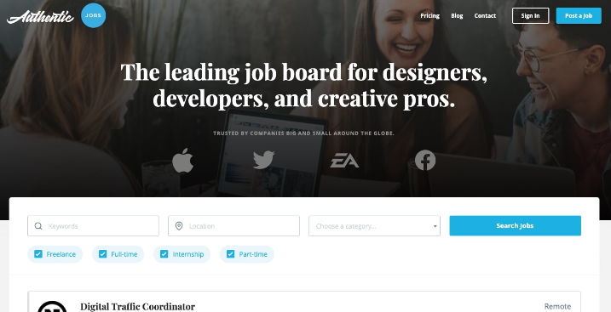
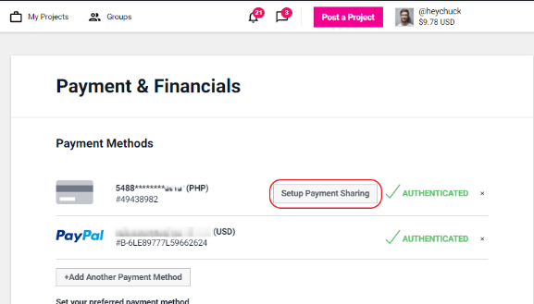
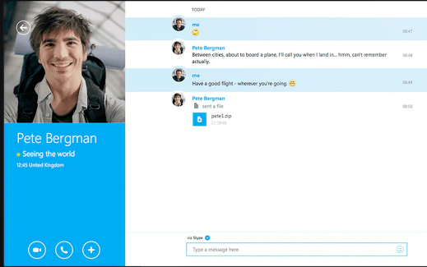

Slide 6
INDUSTRIAL BUILDINS
SUBWAY STATIONS
Jupiter is a gas giant and the biggest planet in our Solar System. It’s the fourth-brightest object in the sky
THANK YOU
Yes, Saturn is the ringed one. This planet is a gas giant, and it’s composed mostly of hydrogen and helium

